Slide 1
Research Paper 1 guidelines

Slide 2
Research paper 1- MSA (at least 4-5pages)
Your paper should include: Framework
Intro- Briefly explain what the paper is about, include background information on S. aureus (bacterial characteristics, what is its natural environment, how is it tested for, etc). Based on a thorough literature review (focus on Staphylococcus aureus being part of the normal flora on humans and MRSA).
Refer next slide for Details
Materials and Methods- Explain in complete sentences how the experiment was performed. With the materials that were used.
Results- 2 pie charts (as discussed in class) and a text-based explanation of the pie charts.
In complete sentences, discuss the results of your individual plate results, your section’s results (include percentages of positive S. aureus students for nose, arms.
Discussion: based on both literature reviews and results obtained from the experiment. Talk about overall population statistics and compare your class results to these numbers; how does the class compare? Do your individual plate results make sense (i.e. if you are positive do you show symptoms of having S. aureus, like acne, boils)?
Details in Slide 5
Conclusion- Discuss the relevance of S. aureus and MRSA; give carrier statistics. 2-3 lines Max.

Slide 3
Introduction (Must have these information) (1-1.5 page)
What is Staphylococci? What is Staph. aureus, Morphology
Habitat of the bacterium and growth conditions
How is it tested in lab, its characteristics.
Disease caused
Carriage rate: (nasal and skin): include some statistics, percentage carriage rate (you will find this in published papers /journals): Do not forget to cite the paper/ article you got that information from.
Significance: why is it important why we are doing this ? Why we are trying to find out the carriage rate?

Slide 4
Materials and Methods- Explain in complete sentences how the experiment was performed. With the materials that were used.
List every single materials (Swab, Sterile ddWater, Inoculating loop, Media you used, Bunsen burner, incubator etc.)
Results- 2 pie charts (as discussed in class) and a text-based explanation of the pie charts.
In complete sentences, discuss the results of your individual plate results, your section’s results (include percentages of positive S. aureus students for nose, arms.

Slide 5
Discussion: 1.5-2 pages: In text Citation is must
What was your result in nose and arm?
How does the data from Nose compares to arm?
What is the average nasal carriage rate? what about skin carriage rate?
How does your data compares to the other national/international/world data?
Spectrum of disease caused by Staphylococci
Do your individual plate results make sense (i.e. if you are positive do you show symptoms of having S. aureus, like acne, boils)?
Antibiotics resistance in Staphylococcus aureus
Talk about Methicillin resistant Staphylococci/ S. aureus
Preventive measures that a carrier should take. ( Consider the fact that they could be latent carrier, might act as a source of outbreak)

Slide 6
How to do in-text citation ?? In your Introduction, Discussion section.
Just an example
A large proportion of the population (Approx. 60%) harbors S. aureus intermittently(Esther and Smith, 1976). This is how you do intext citation.
The detail of authors goes into your separate reference section like:
Esther, C. A., and Smith J.E . 1976. Carriage patterns of Staphylococcus aureus in a healthy non-hospital population of adults and children. Ann. Hum. Biol. 3:221–227.

Slide 7
Examples of in-text citations
Citing a website: include website’s name and year it was accessed
  The U.S. demand for gasoline is almost 9 million barrels per day, which depends heavily on importing foreign oil (EIA, 2013).
Citing a journal or book with 1 author: include author’s last name and year of publication
  (Alasfour, 1997)
Citing a journal or book with 2 authors: include both last names and year of publication
  (Nigam and Singh, 2011)
Citing a journal or book with more than 2 authors: include first author’s last name followed by “et al.” and year of publication.
  (Wu et al. 2008)

Slide 8
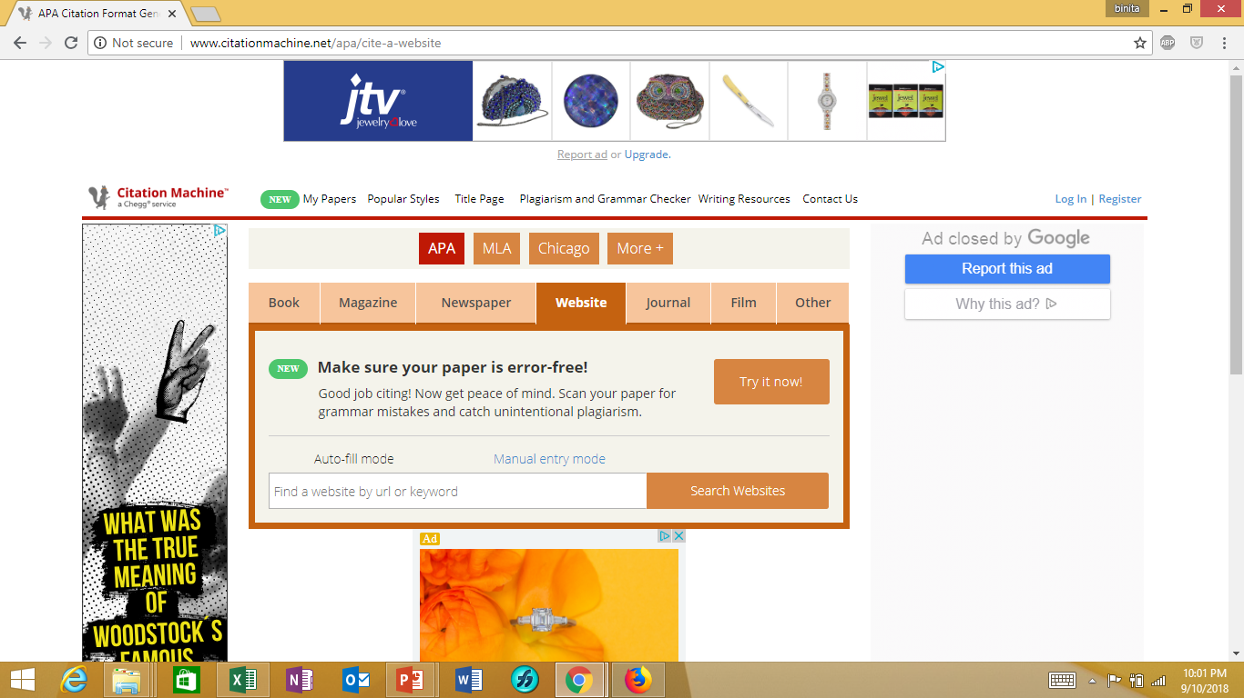
Reference: Last section: separate page
Use Citation Machine to generate your references and Bibliography

Slide 9
References
Your reference page should be the last page of your paper (this does not count towards the 4-5 pages) and should be labeled “References”
Make sure you include a reference for all in-text citations
References should be in alphabetical order
Each reference should be indented after the first line
When referencing a website you must include the name of the website, the date the information was posted, the name of the section the information was taken from, the date it was accessed, and the website address
When referencing a book or journal you must list every author’s name no matter how many there are

Slide 10
Example of references
Referencing a journal article with a single author: Include the article’s name, abbreviated journal name, journal issue, and page numbers of article
Alasfour, F.N. (1997) Butanol-A single cylinder engine study: engine performance. Int J Energy Res 21:21-30.
Referencing a journal with multiple author’s: include all names
Atsumi, S., Cann, A.F., Connor, M.R., Shen, C.R., Smith, K.m., Brynildsen, M.P., Chou, K.J.Y., Hanai, T., & Liao, J.C. (2008) Metabolic engineering of Escherichia coli for 1-butanol production. Metab Eng 10(6):305-311.
Referencing a website: publish/post date is listed first, then access date
Energy Information Administration (2011) International Energy Statistics. 20 Oct. 2013 <http://www.eia.gov/cfapps/ipdbproject/IEDIndex3.cfm?tid=79&pid= 79&aid=1>.
Referencing a book: follow same rules as journal articles with multiple authors
Last, F. M. (Year Published) Book name. City, State: Publisher.

Slide 11
Miscellaneous
The first time you mention an organism’s name you must spell it out completely. Any time it is mentioned after that you can abbreviate the genus name.
Scientific names are always written in italics, and the genus is always capitalized
Ex) Escherichia coli ; when it is mentioned later you can abbreviate it (E. coli)
Plagiarism will result in a 0

